Slide 1


Bright School : Vadodara
CBSE Unit : Karelibaug
Presented by – Ashwini Meshram
Designation – IT Specialist

Slide 2
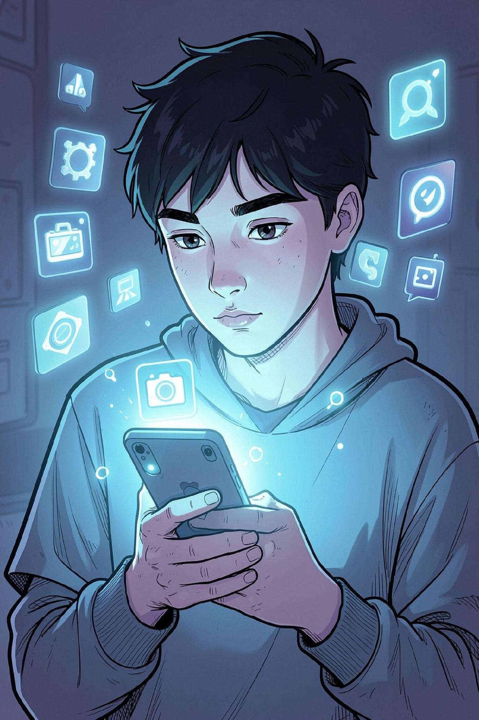
The Digital Age: More Than Just Gadgets
What It Is
Digital literacy means using technology effectively, responsibly, and safely — not just knowing how to tap a screen.
What It Means
It's about understanding, evaluating, and creating information — not just consuming it passively.

Slide 3
The 9 Elements of Digital Citizenship
These pillars form the foundation of how we interact with the digital world — responsibly and respectfully.
Access
Commerce
Communication
Equitable digital participation
Buying and selling online safely
Exchanging information digitally
Literacy
Etiquette
Law
Learning and teaching with tech
Standards of online conduct
Responsibility for online actions
Rights & Responsibilities
Health & Wellness
Security
Freedoms and duties online
Physical and mental well-being
Protecting digital information

Slide 4
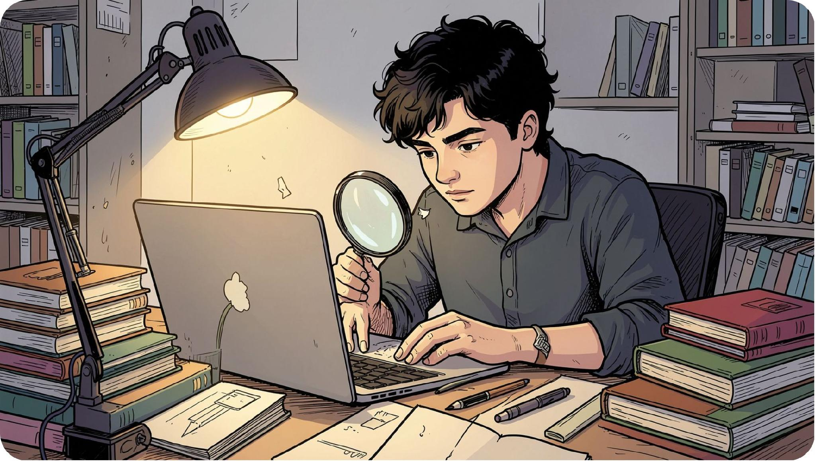
CRITICAL THINKING
Information Literacy: Finding the Truth
The internet is vast — but not everything online is accurate or trustworthy. Learning to evaluate sources is a superpower.
Search Effectively
Evaluate Sources
Verify Before Sharing
Use specific keywords and trusted search engines.
Check who wrote it, when, and why.
Fact-check using multiple reliable sources.

Slide 5
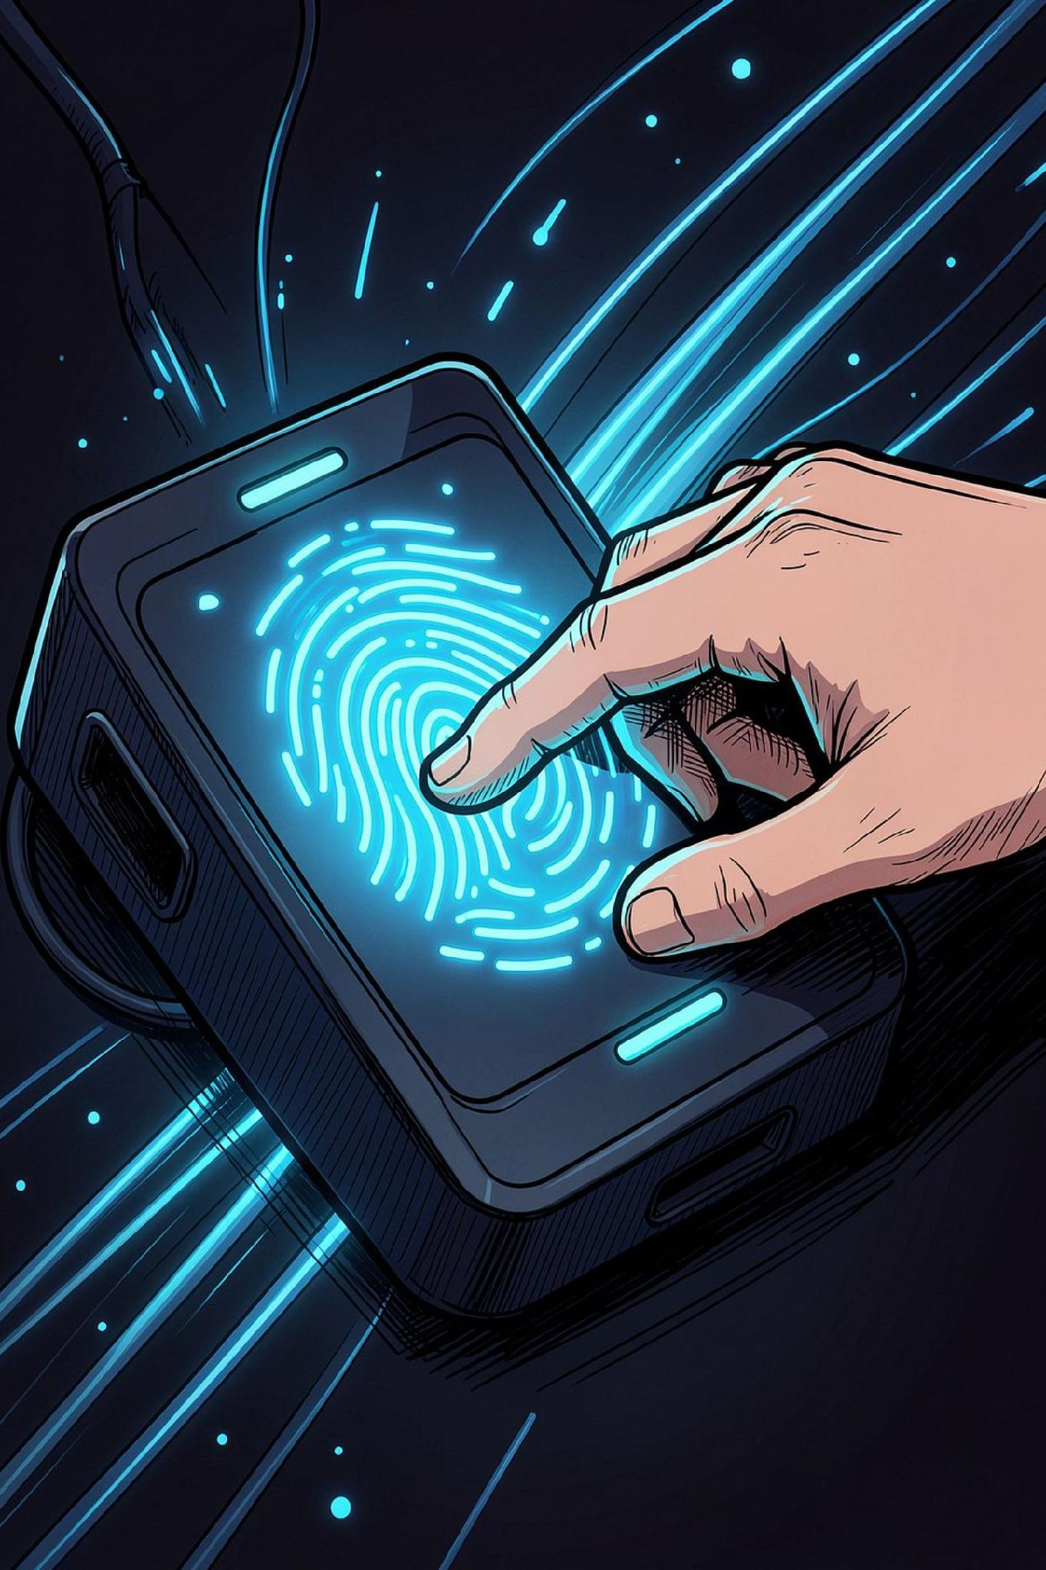

The Digital Tattoo: Your Online Footprint
Unlike a footprint, a digital tattoo is nearly impossible to erase. Every post, like, and comment stays.
🤔 Ask Yourself Before You Post
Is this respectful? Is it accurate? Would I be comfortable if my future employer or family saw this?
🔒 Manage Your Privacy
Review your privacy settings regularly and think carefully about what personal information you share publicly.

Slide 6
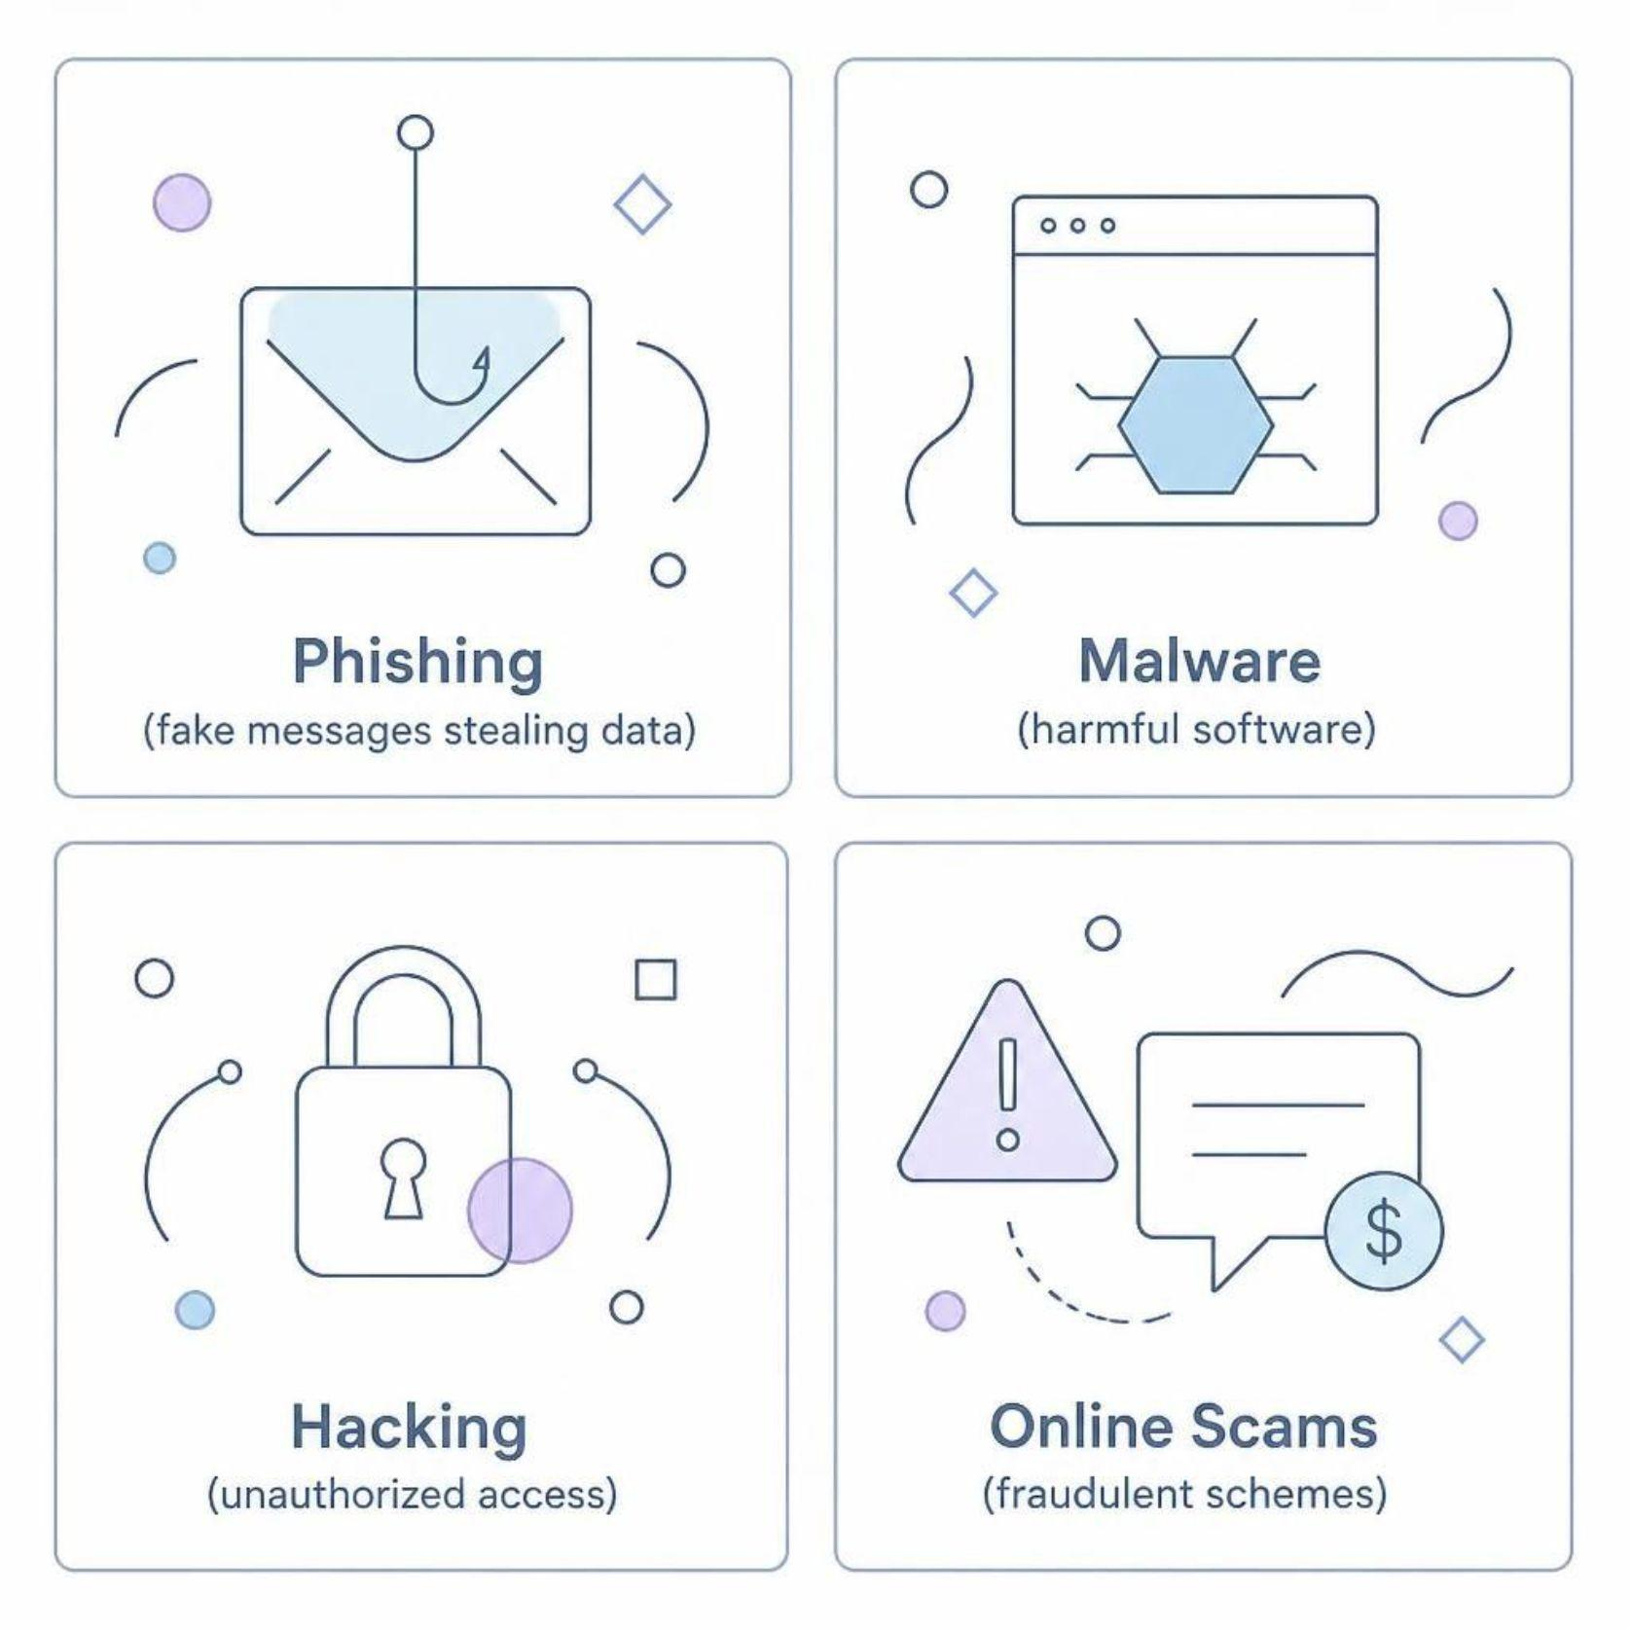
Cyber Safety: Protecting Your Digital Life
Best Practices to Stay Safe
1
Strong, Unique Passwords
Use a mix of letters, numbers, and symbols. Never reuse passwords.
2
Enable Two-Factor Authentication
Adds an extra layer of security to your accounts.
3
Guard Personal Details
Never share your home address, OTPs, or private information online.

Slide 7
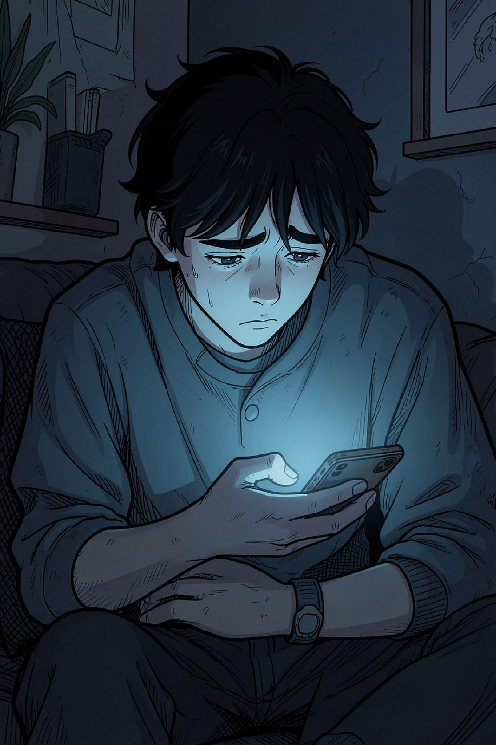

The Reality of Cyberbullying
1 in 4
Children Bullied Online
Cyberbullying affects millions of young people worldwide.
#1
Australia's Ranking
Highest rate of social network bullying globally.
If you are a victim: Tell a trusted adult immediately. Use the platform's reporting tools. You are not alone, and it is never your fault.

Slide 8
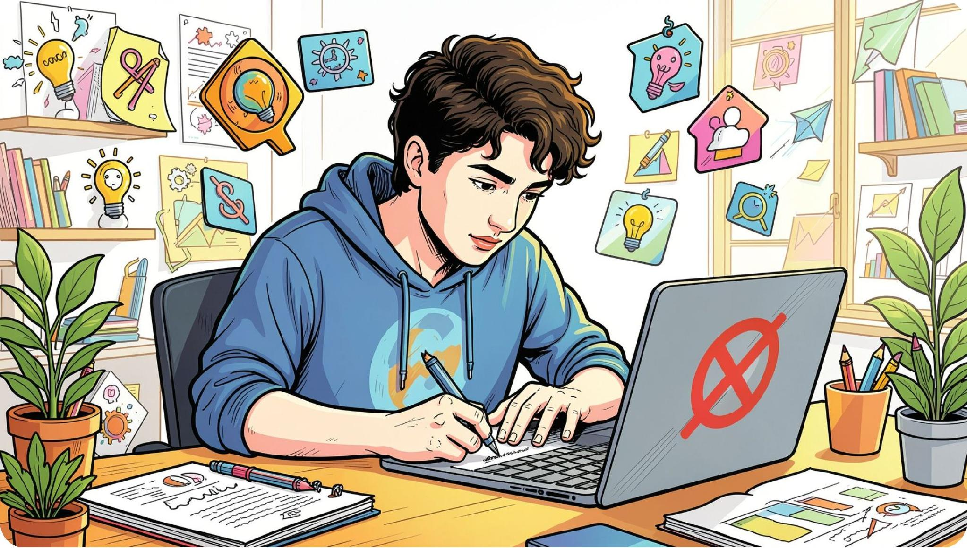
DIGITAL ETHICS
Doing What Is Right Online
Your online actions have real-life consequences. Ethical behavior builds trust and respect in the digital world.
1
2
3
Respect Copyright
Avoid Plagiarism
Think Before Posting
Always credit the original creator when using their work.
Never copy someone else's work without acknowledgment.
Consider how your words might affect others in real life.

Slide 9
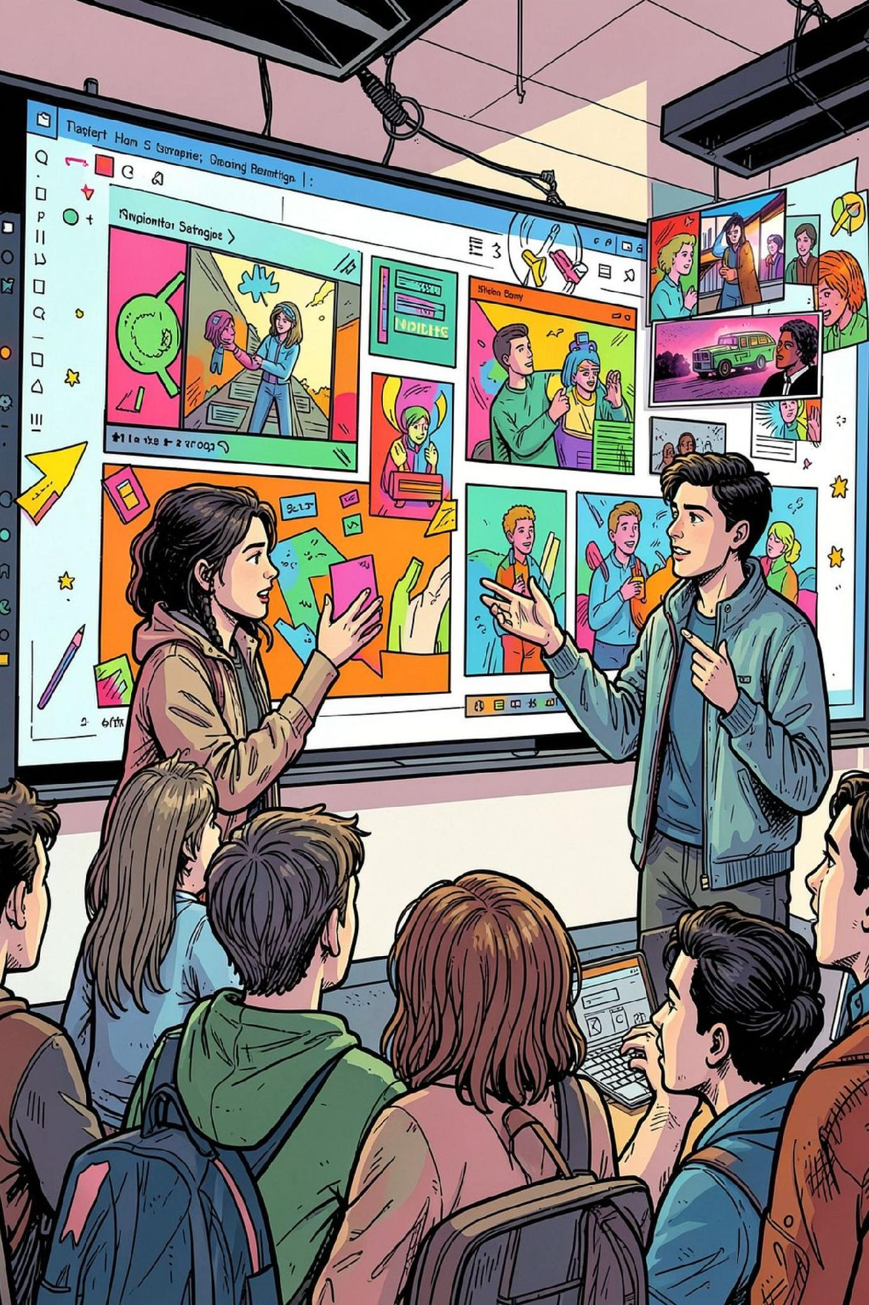
The Power of Digital Creation
Technology isn't just for consuming — it's for creating, solving problems, and expressing yourself.
🎨 Express Creativity
📊 Multi-Modal Presentations
Design, code, film, write — the digital world is your canvas.
Combine text, visuals, and audio to communicate research effectively.
💡 Solve Real Problems
Use digital tools to address challenges in your community and beyond.

Slide 10
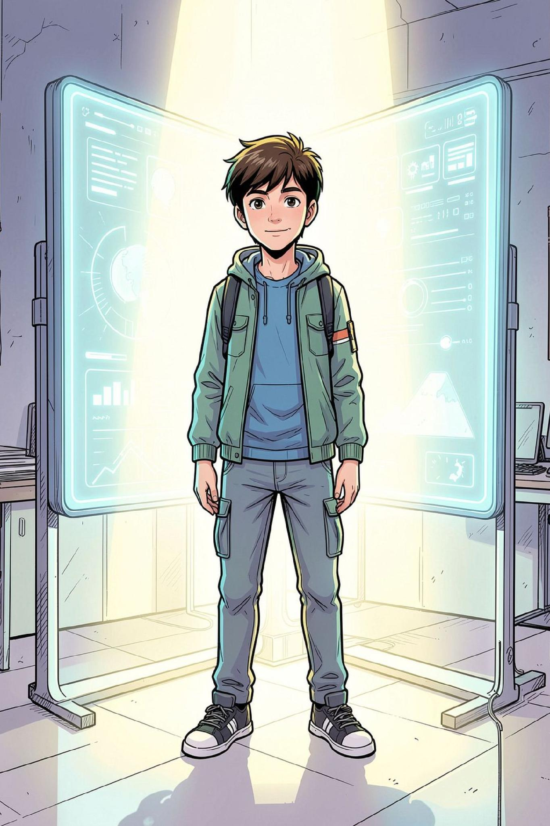
Your Call to Action
The Best Filter Is in Your Head
You are the architect of your own digital reputation. Every choice you make online shapes who you are.
Protect
Respect
Guard your information and privacy.
Treat others online as you would in person.
Think
Always pause and reflect before you post.

Slide 11

Conclusion – Use your technology effectively, responsibly and safely.
Thank You!

